Slide 1
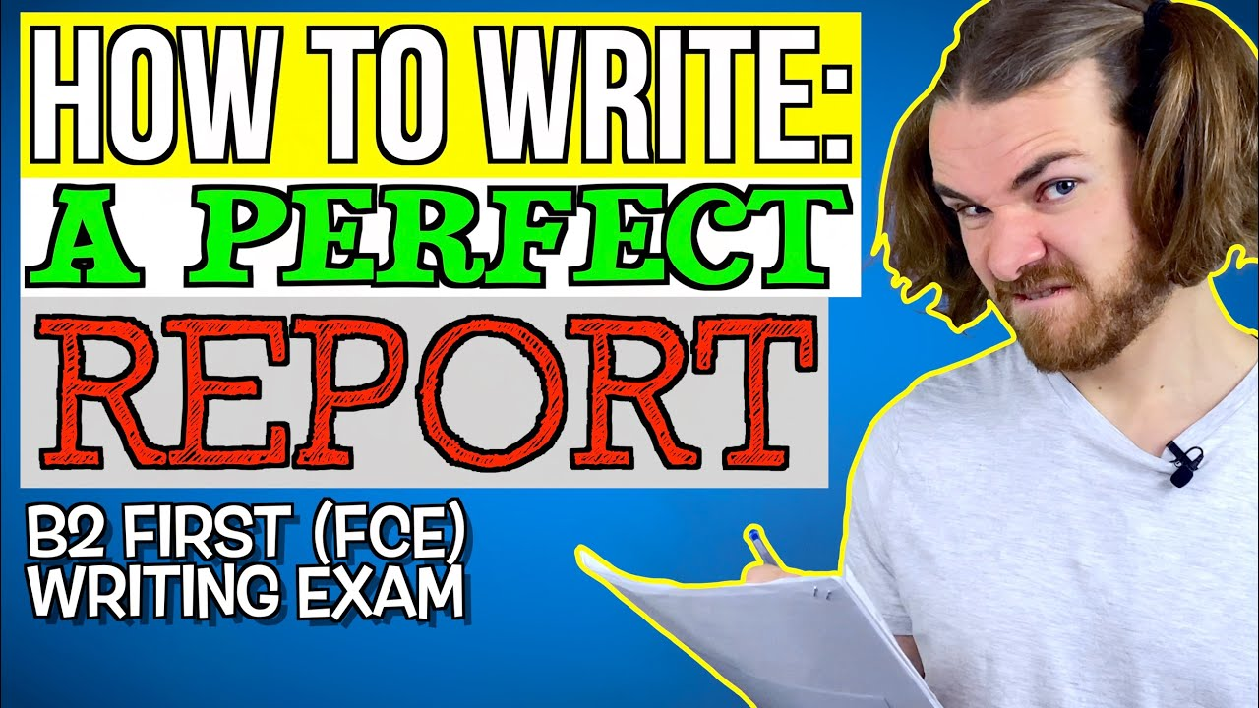
Maybe Wishful Thinking, But I Will Try!

Slide 2



Your Undertaking
Your Role(s)
a person who designs buildings and advises in their construction, or
a person who designs and guides a plan or undertaking
A person who constructs something by putting parts or materials together over a period of time

Slide 3




What are Your Building Materials?
Pleadings: Complaint, Answers to Interrogatories, Motions, Affidavits; Deposition Transcripts, Document Production from all parties, Expert’s Reports

Slide 4
The Expert’s Report: Today’s Agenda
  In General
Contact with retaining counsel
Defining the scope of the assignment
Setting appropriate parameters
Obtaining an executed letter of engagement with retainer fee
Groundwork
2. i. Collecting all information relevant to the assignment
  ii. Document reviews
  iii. Deposition Reviews
  3. Conversations with Counsel
  4. Conversations with Party Litigant: None

Slide 5

The Expert’s Report: In General
Listen to the broad-brush outline of the facts from prospective retaining counsel, but do not lose sight of the fact that these facts are generally based on what the client has described.
  Warning signs:
  “I need an expert who can give me an opinion that . . .”
  I need an opinion by the end of this week
  All other potential experts have turned me down
  I will have to check with my client before I can send you a retainer
Don’t rush to judgment. Make sure the attorney knows this is only a preliminary opinion based upon what you have been told and that it is possible after review you cannot be of assistance.

Slide 6
The Expert’s Report:
Suggested Language For An Expert Witness Following Initial Contact By An Attorney.
Depending on the circumstances surrounding the initial discussions between the expert and the contacting attorney, the following are several suggested statements that could be included in the confirmation the expert sends to the attorney.
My understanding is that I have not been retained in this case.
The ideas you and I discussed should be considered speculative comments regarding possible opinions and should not be used as opinions in this case until I have been formally retained and supplied documents necessary to fully assess the facts and circumstances to form a concrete opinion that is supported by actual evidence.
You and I did not exchange confidential information regarding this case.
Until I have received an executed engagement letter and the necessary retainer fee, I will not consider myself retained in this case.
If I am not retained within __ days, I will take that to mean that you will not be engaging my services and will be free to consider an engagement with any other party in this case.

Slide 7

The Expert’s Report:
BUILDING THE FOUNDATIONS OF YOUR REPORT
I. Document Review
II. Deposition Summaries
III. Conversations with Counsel.
Drafting the Report
What are the purposes of the expert report?
1. Impress the attorney who hired you?;
2. Demonstrate to opposing counsel your grasp of the facts as well as a firm understanding of
the principles applicable to your opinion.
3. You are not an “advocate” for the retaining party. Your advocacy is on behalf of your opinion.
Expert

Slide 8
The Expert’s Report: Document Review
1. Make sure you have all pertinent documents. This includes depositions.
If there are documents you believe are necessary and will assist you
in formulating your opinion, ask for them.
2. DO NOT place any comments on the documents you review.
DO NOT highlight or annotate anything in the documents or depositions.
When summarizing or outlining a document, make literal, objective
observations, DO NOT add any subjective comments, reserve these for
your report.
3. Create templates for deposition summaries and document reviews.
Be consistent in your review.

Slide 9
The Expert’s Report:
This is the type of review
to avoid. You can see how these notes can be used to impeach the expert and any subsequent opinion.
This review was based only on what the expert had been told by the retaining attorney.
This was the expert’s first ever assignment.

Slide 10
Plaintiff vs. Defendant
In the United States District Court
Case No.: 2020 CV-0001-SLL
DATE/BATES DESCRIPTION
Document Review
This is a suggested format/template for document review. Add a footer with the case identity and page number.
If reviewing by date, use the filing date for documents such as the Complaint, Answer, Interrogatory and Document Productions.
The note, notation or quote should contain ONLY objective, empirical information. DO NOT enter any subjective observations here.

Slide 11

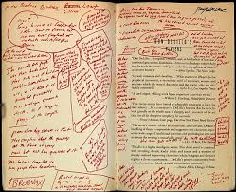
DEPOSITION SUMMARY/PRECIS
Deposition summaries:
Accuracy is important. Although time consuming, they are an invaluable tool when it comes time to prepare a written report.
The expert is looking only for facts. The expert should look for ideas and continuity of performance.
Refrain from subjective comments.
Please, no marginalia in the deposition transcript!!! They are a gold mine for any attorney.
Law Firm/Client [Deponent] Page 1 of 1

Slide 12
The Expert’s Report:
    Federal Rule 26(a)(2)(B) is the perfect template for the expert’s report.
    The expert MUST write the entire report and must be prepared to testify, under oath, that no one other than the expert, wrote the report.
    Drafts are now, under the federal rules, NOT DISCOVERABLE,*
    FRCP 26(b)(C)(4), Trial-preparation: Experts. (B) Trial-Preparation Protection for Draft Reports or Disclosures. Rules 26(b)(3)(A) and (B) protect drafts of any report or disclosure required under Rule 26(a)(2), regardless of the form in which the draft is recorded.
    (C) Trial-Preparation Protection for Communications Between a Party’s Attorney and Expert Witnesses. Rules 26(B)(3)(A) and (B) protect the communications between the party’s attorney and any witness required to provide a report under Rule 26(a)(2)(B), regardless of the of the communications, except to the extent that the communications: (i) relate to compensation for the expert’s study or testimony; (ii) identify facts or data that the party’s attorney provided and that the expert considered in forming the opinions expressed; or (iii) identify assumptions that the party’s attorney provided and that the expert relied on in forming the opinions to be expressed.
    *Always check with the retaining attorney as some federal courts use local rules that modify this rule.

Slide 13
The Expert’s Report: Federal Rule 26(a)(2)(B)
Federal Rules of Civil Procedure, Rule 26(a)(2)(B): Witnesses Who Must Provide a Written Report. Unless otherwise stipulated or ordered by the court, this disclosure must be accompanied by a written report – prepared and signed by the witness – if the witness is one retained or specially employed to provide expert testimony in the case ….
The report must contain:
a complete statement of all opinions the witness will express and the basis and reasons for them;
(ii) the facts or data considered by the witness in forming them;
(iii) any exhibits that will be used to summarize or support them;
(iv) the witness’s qualifications, including a list of all publications authored in the previous 10 years;
(v) a list of all other cases in which, during the previous 4 years, the witness testified as an expert at trial or by deposition; and
(vi) a statement of the compensation to be paid for the study and testimony in the case.

Slide 14
The Expert’s Report: Federal Rule 26(a)(2)(B)
A list of all other cases in which, during the previous 4 years, the witness testified as an expert at trial or by deposition
The case list should provide:
(1) the case name;
(2) the court/jurisdiction in which the case was brought/heard;
(3) the case number; and
(4) the dates of deposition and trial.
Avoid providing the identity of counsel. Destroy or delete deposition transcripts once the case has been concluded.

Slide 15

Writing the Report

Slide 16
INTRODUCTION
The Introduction serves several purposes: First, it is a synopsis of the most important aspects of your background and how your expertise allows an expert to render an opinion on the subject matter. Second, the final paragraph sets forth the task the expert has undertaken. In federal cases a sentence must be added to detail the compensation to be paid for the review and testimony

Slide 17

Summary of Opinions
Stay Tuned.

Slide 18
DOCUMENTS REVIEWED AND RELIED UPON
This section sets out all the documents and depositions the expert has reviewed. It should be comprehensive to include all documents reviewed. If a document was reviewed but not relied upon as a basis for the report, it should be listed then footnoted as not having been relied upon. An example of this would be the opposing expert’s report (unless this report is a rebuttal). There should be a corresponding entry in the expert’s time records demonstrating the review of the documents and depositions. The time entries will usually be requested for the expert’s deposition.

Slide 19
FACTUAL BACKGROUND
Other than the Discussion Section this is the most important section in the report. It is the FOUNDATION that establishes the factual support for your opinion. It also provides a chronology of events and is an excellent review summary for deposition or trial.
Selecting appropriate facts: there is no actual hierarchy of facts. However, whenever possible, choose facts in this order: 1) Facts adduced by the “other side” either by deposition, Answers to Interrogatories, documents produced or even the Complaint when appropriate; 2) All statements made under oath by witnesses of either side; 3) All documents produced during discovery. (Documents don’t lie)

Slide 20
MORE FACTUAL BACKGROUND STUFF
Use Footnotes!
Recitation of facts in the Foundation must be organic and objective without any comment(s) [comments should be saved for the Discussion portion of the report].
This is when all of your hard work pays off: Document Review and Deposition Summaries are now a quick reference to the record and location of facts. Adding a reference to a fact usually prevents the accusation of “cherry picking”.

Slide 21
DISCUSSION
David Schwarz and B. F. Saul Agency met the applicable standard of care in procuring the policies requested by their client, D T M Corporation, by providing the insurance policies requested, accepted and ratified by D T M Corporation
An insurance agent’s duty is to follow the client’s instructions and obtain the best insurance for the most commercially reasonable price and terms, using reasonable skill and ordinary diligence. B. F. Saul obtained the insurance coverage requested by its insured, including workers compensation, automobile, general liability, umbrella liability and commercial property. An insurance agent is expected to rely upon the information provided by its insured, and that such information is truthful and complete. The agent is not required to inquire beyond the information provided by the insured unless that information is incomplete or missing. In this instance, DTM completed the applications and provided them to B. F. Saul for submission to Brownyard. Neither Brownyard, as the managing general agent, nor Arch Insurance Company, as the issuing insurer, questioned the content of the applications or requested more information.
Beginning in August 2003, DTM accepted general liability and umbrella policies with alarm exclusions. If the general liability and umbrella policies were not the policies requested,
15 The Department of Defense contract with DTM contained no specific [limit] amount according to DTM’s Chief Operating Officer, Margo Briggs, who stated that the Federal Acquisition Requirement (FAR), dealing with insurance limits was not incorporated into the contract. BFS 3-4. The policies provided insurance sufficient to satisfy the contracting requirement. The allegation in ¶30 of the Complaint that DTM was “grossly underinsured” has no merit. DTM requested and accepted the limits in the policy.
16 BFS 5.
17 Complaint ¶30. This allegation is made even though the Umbrella Liability Policy’s limits were $5 Million.
18 BFS 2230. “ALARM SYSTEMS. Any liability arising out of or caused or contributed to by the ownership, maintenance, operation, use or installation of any alarm, alarm device, alarm component or alarm system.” This exclusion could be considered more restrictive than the Alarm Systems exclusion contained in the Arch Insurance Company policy discussed in footnote 12 above because of the language referring to “any liability”.
DISCUSSION
This is the most important part of your report, your opinion(s).
If discovery has not concluded, be certain to reserve the right to amend or supplement your report

Slide 22
It is perfectly acceptable
to list each opinion separately, especially when based upon the factual predicate established by the expert.
However, causing the reader [opposing counsel] to put together the puzzle pieces that support the opinion not only weakens the opinion but leaves the expert open to various challenges of each item.
This is an example of why building a comprehensive factual predicate is important.

Slide 23
This approach to report writing also demonstrates why a factual predicate is so important. Note that the report contains ten separate opinions. The “BASIS FOR MY OPINIONS ABOVE” requires the readers [both counsel] to match up the stated basis for the opinions with the opinions.
There is no comprehensive factual predicate tied to a specific opinion, just pieces of information/facts selected by the author, leaving the writer open to the “cherry picking” accusation.

Slide 24
Avoid using authorities
that are not applicable or generally accepted throughout the industry.
Stay away from playing attorney. In this report by a non-attorney, the purported legal basis was completely incorrect, and the expert was requested by retaining counsel to revise the report after being deposed.

Slide 25

The Expert’s Report:

